Slide 1
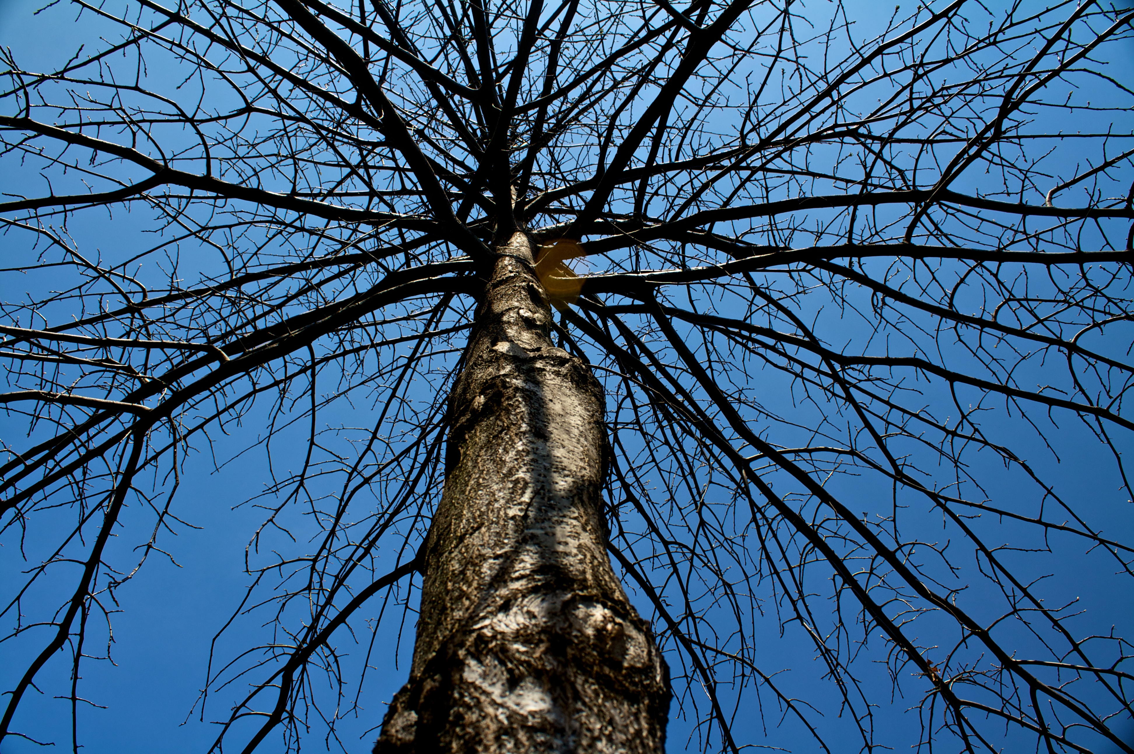
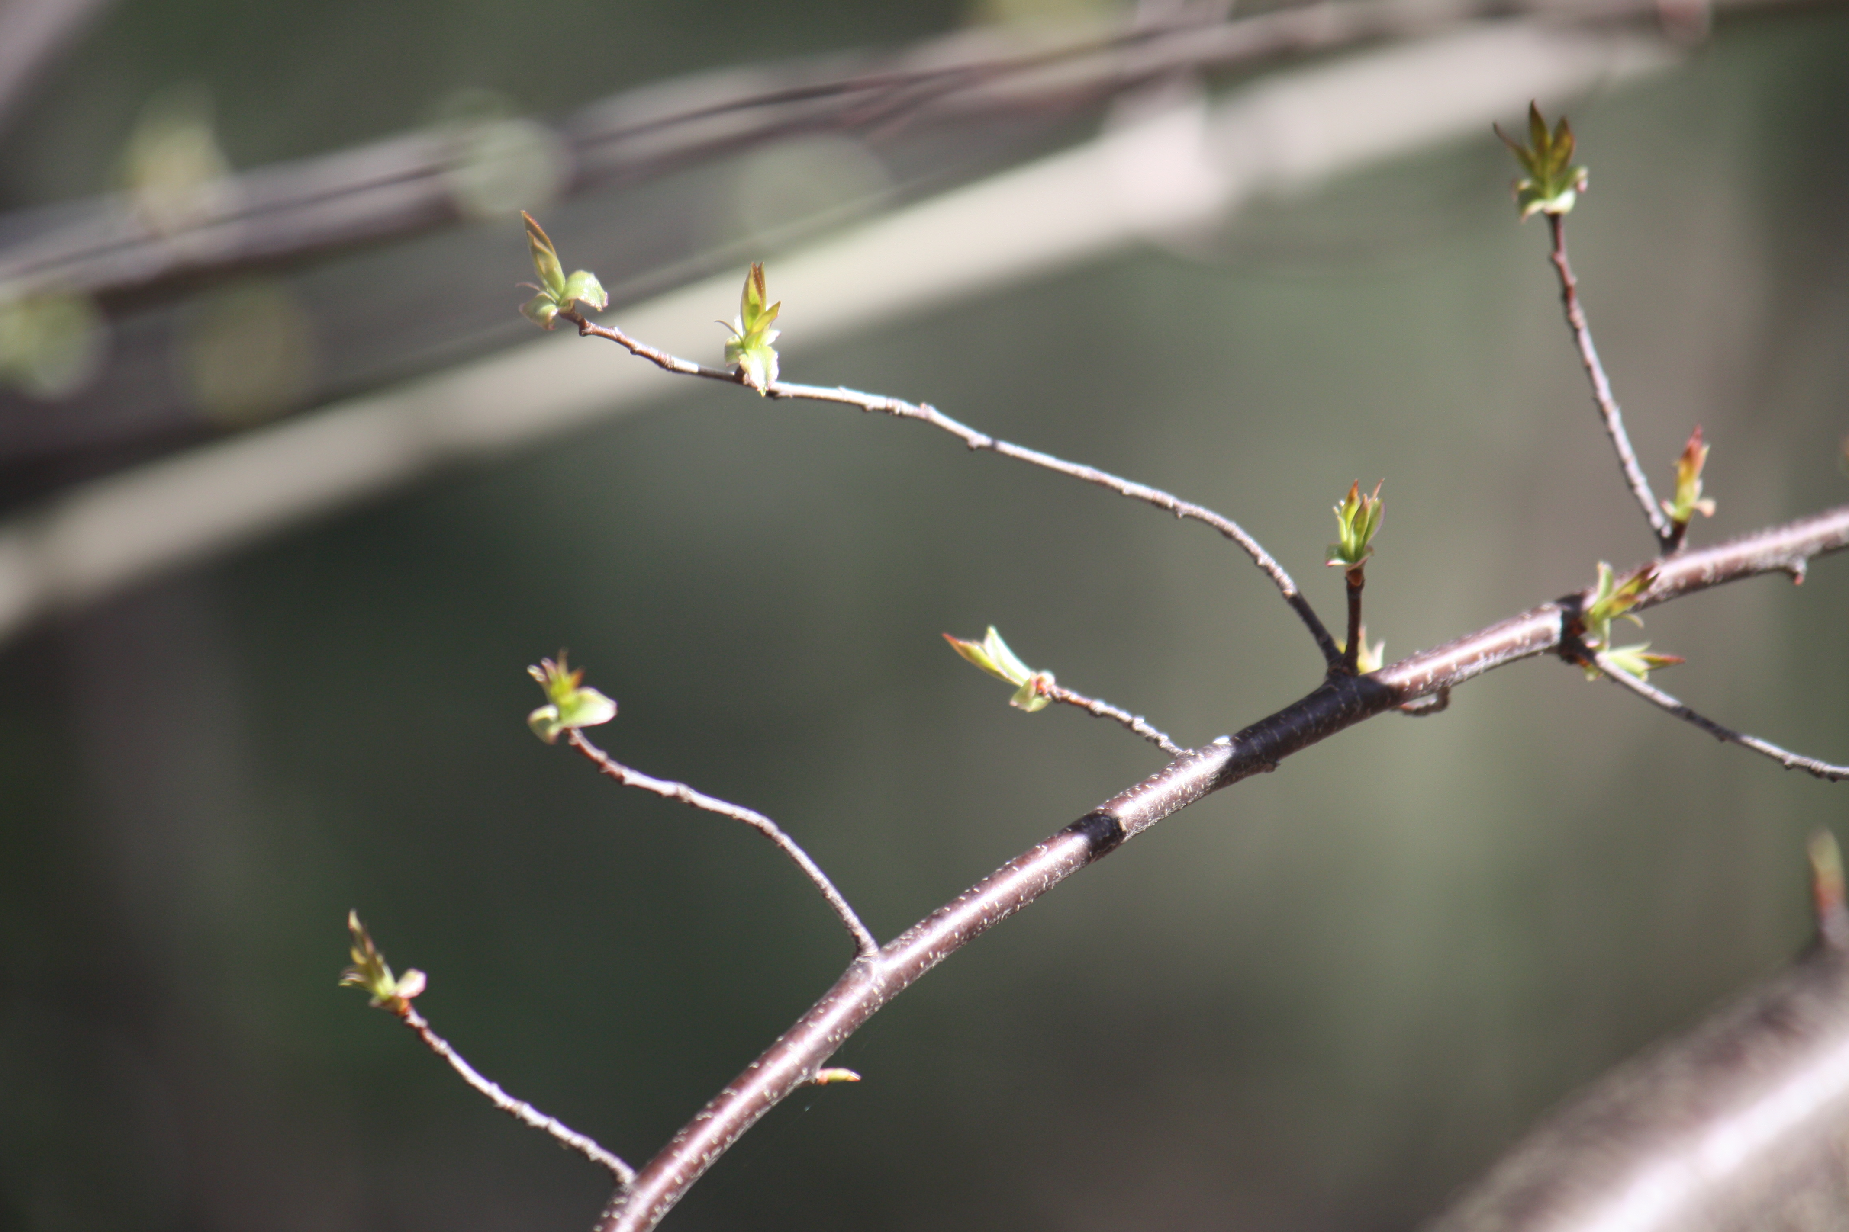
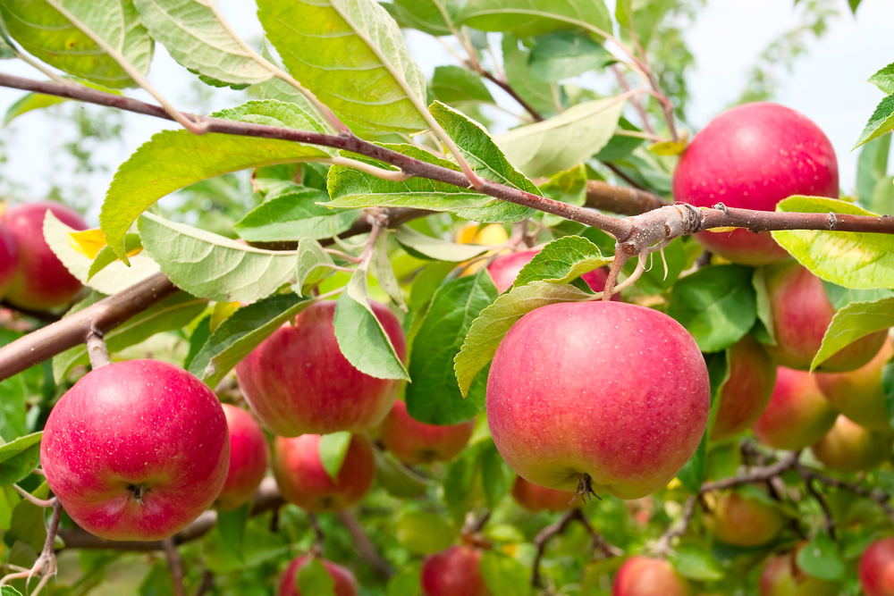
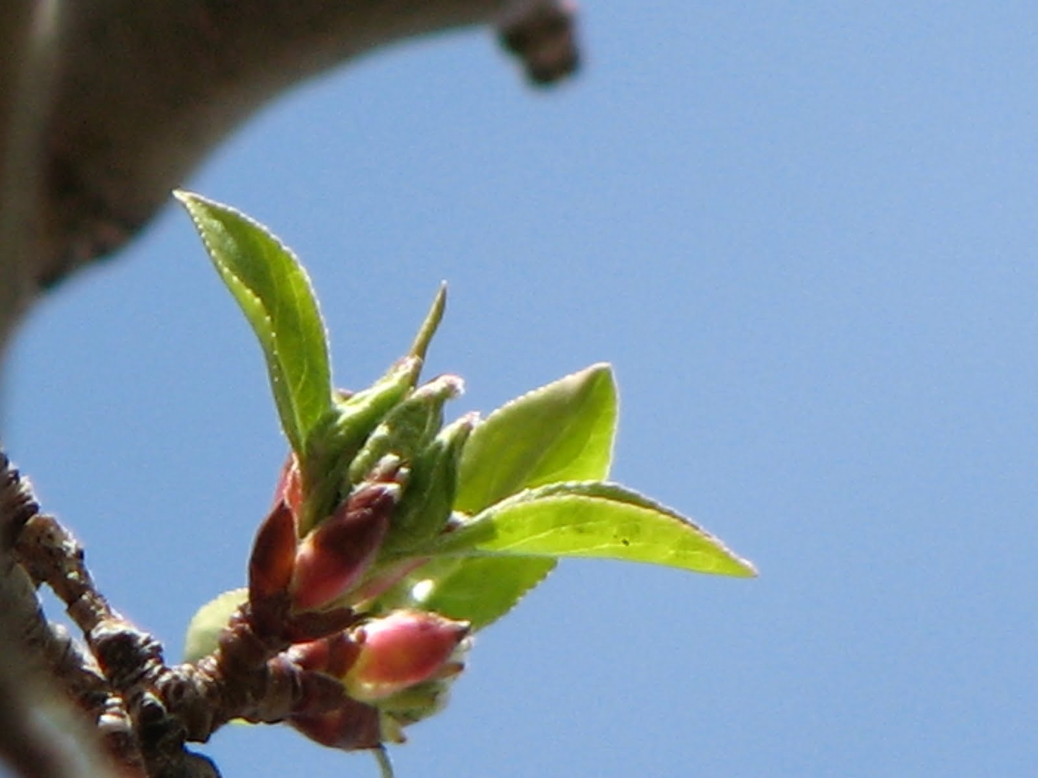
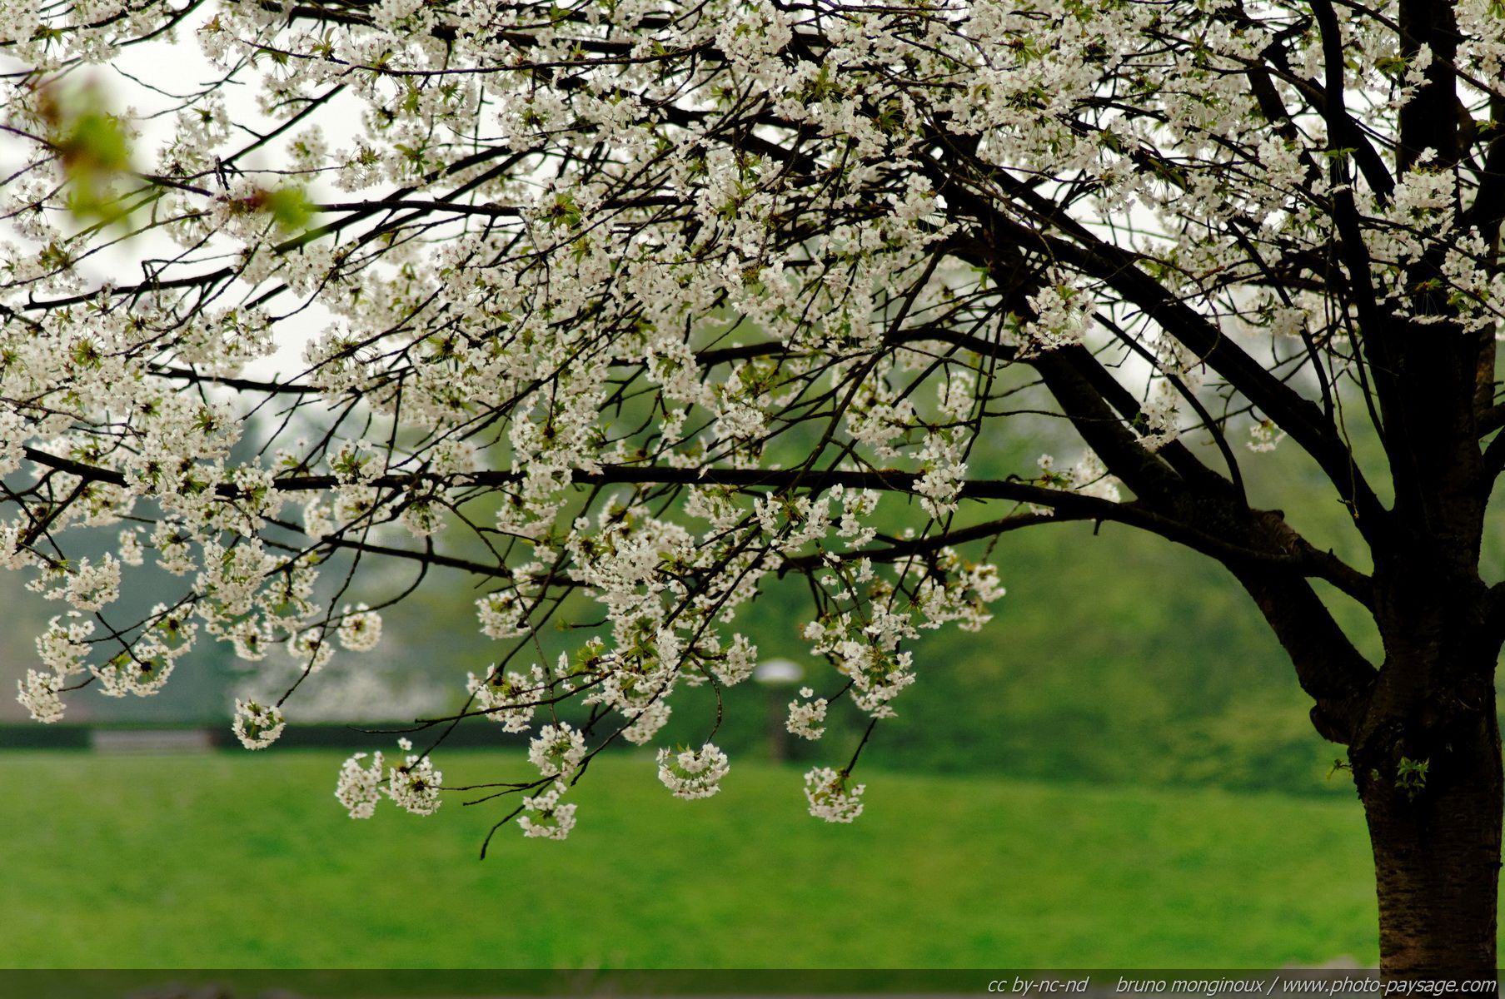
Notes:
Over the past several weeks, I have enjoyed watching the trees. Just a few weeks ago the trees looked dead. No leaves. No sign of life. If you weren’t aware of the seasons, you’d think, this tree is dead and needs to be cut down. But over the last few weeks, signs of life have begun to show in trees and bushes.
The trees and bushes have started to bud, flowers and foliage have burst forth, fragrant smells from flowers are all signs that the tree isn’t dead, but is now awakened to bear its fruit.
God’s creation- how beautiful– how marvelous it is to do what it was meant to do—bear fruit.
What were you meant to do?

Slide 2
Bearing Fruit
John 15
Notes:
In John 15:8, Jesus said, ⁸ Herein is my Father glorified, that ye bear much fruit; so shall ye be my disciples.
Jesus said our purpose is to bear much fruit. If we bear fruit, we will glorify His Father. Jesus said if we bear much fruit, we will be His disciples.

Slide 3
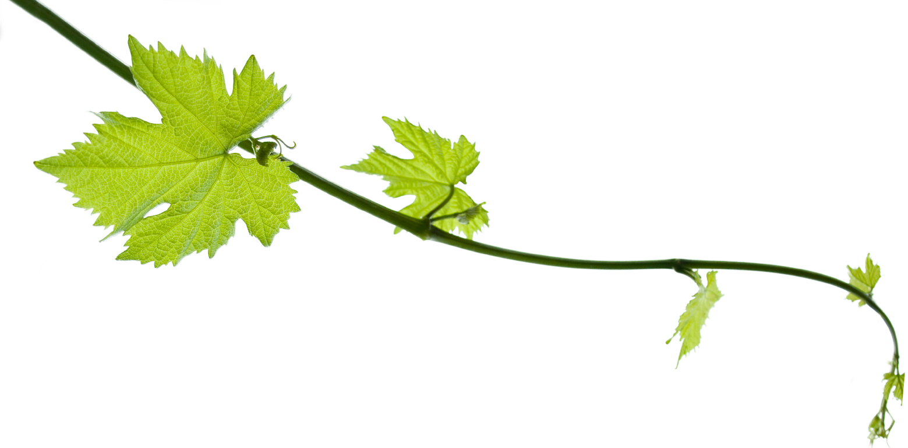
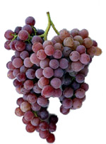
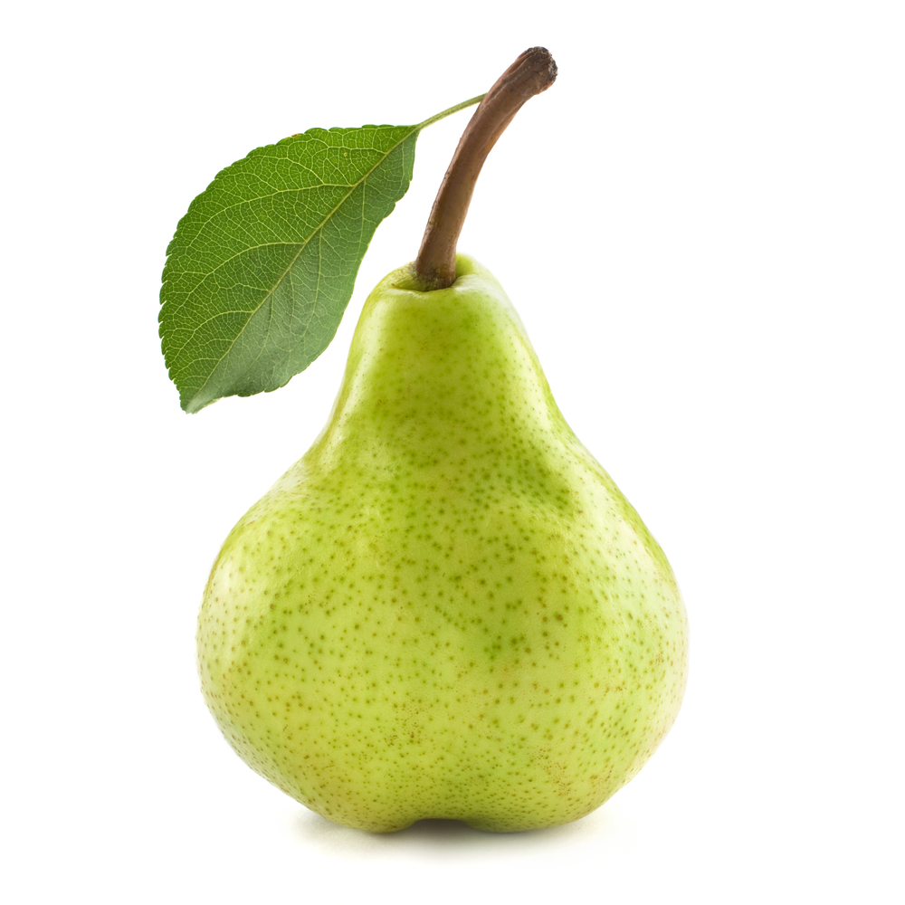
Are We Disciples of Christ?
John 15:5
I am the vine, ye are the branches: He that abideth in me, and I in him, the same bringeth forth much fruit: for without me ye can do nothing.
Notes:
In John 15:5
⁵ I am the vine, ye are the branches: He that abideth in me, and I in him, the same bringeth forth much fruit: for without me ye can do nothing.
If we are disciples of Christ, our branch will produce fruits that are Christ-like.
A grapevine can’t produce anything but grapes. It won’t produce a pear, an apple, a peach, or cherries. It will produce grapes.
We’ve all heard the saying, “There’s proof in the pudding.” Well, we can say also say, there’s proof in the fruit.

Slide 4
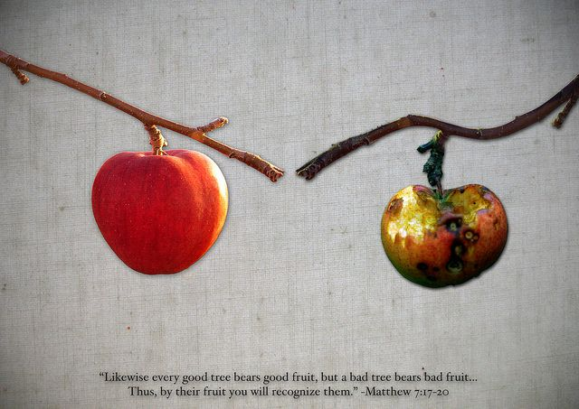
What Fruit Are You Bearing?
Notes:
In nature, fruit is the result of a healthy plant producing what it was designed to produce (Genesis 1:11–12). In the Bible, the word fruit is often used to describe a person’s outward actions that result from the condition of the heart.
What kind of fruit are you bearing?
Is it good fruit or bad fruit?
Jesus said, in Matthew 7:17-20,
¹⁷ Even so every good tree bringeth forth good fruit; but a corrupt tree bringeth forth evil fruit.
¹⁸ A good tree cannot bring forth evil fruit, neither can a corrupt tree bring forth good fruit.
¹⁹ Every tree that bringeth not forth good fruit is hewn down, and cast into the fire.
²⁰ Wherefore by their fruits ye shall know them.
What do your fruits reveal?

Slide 5
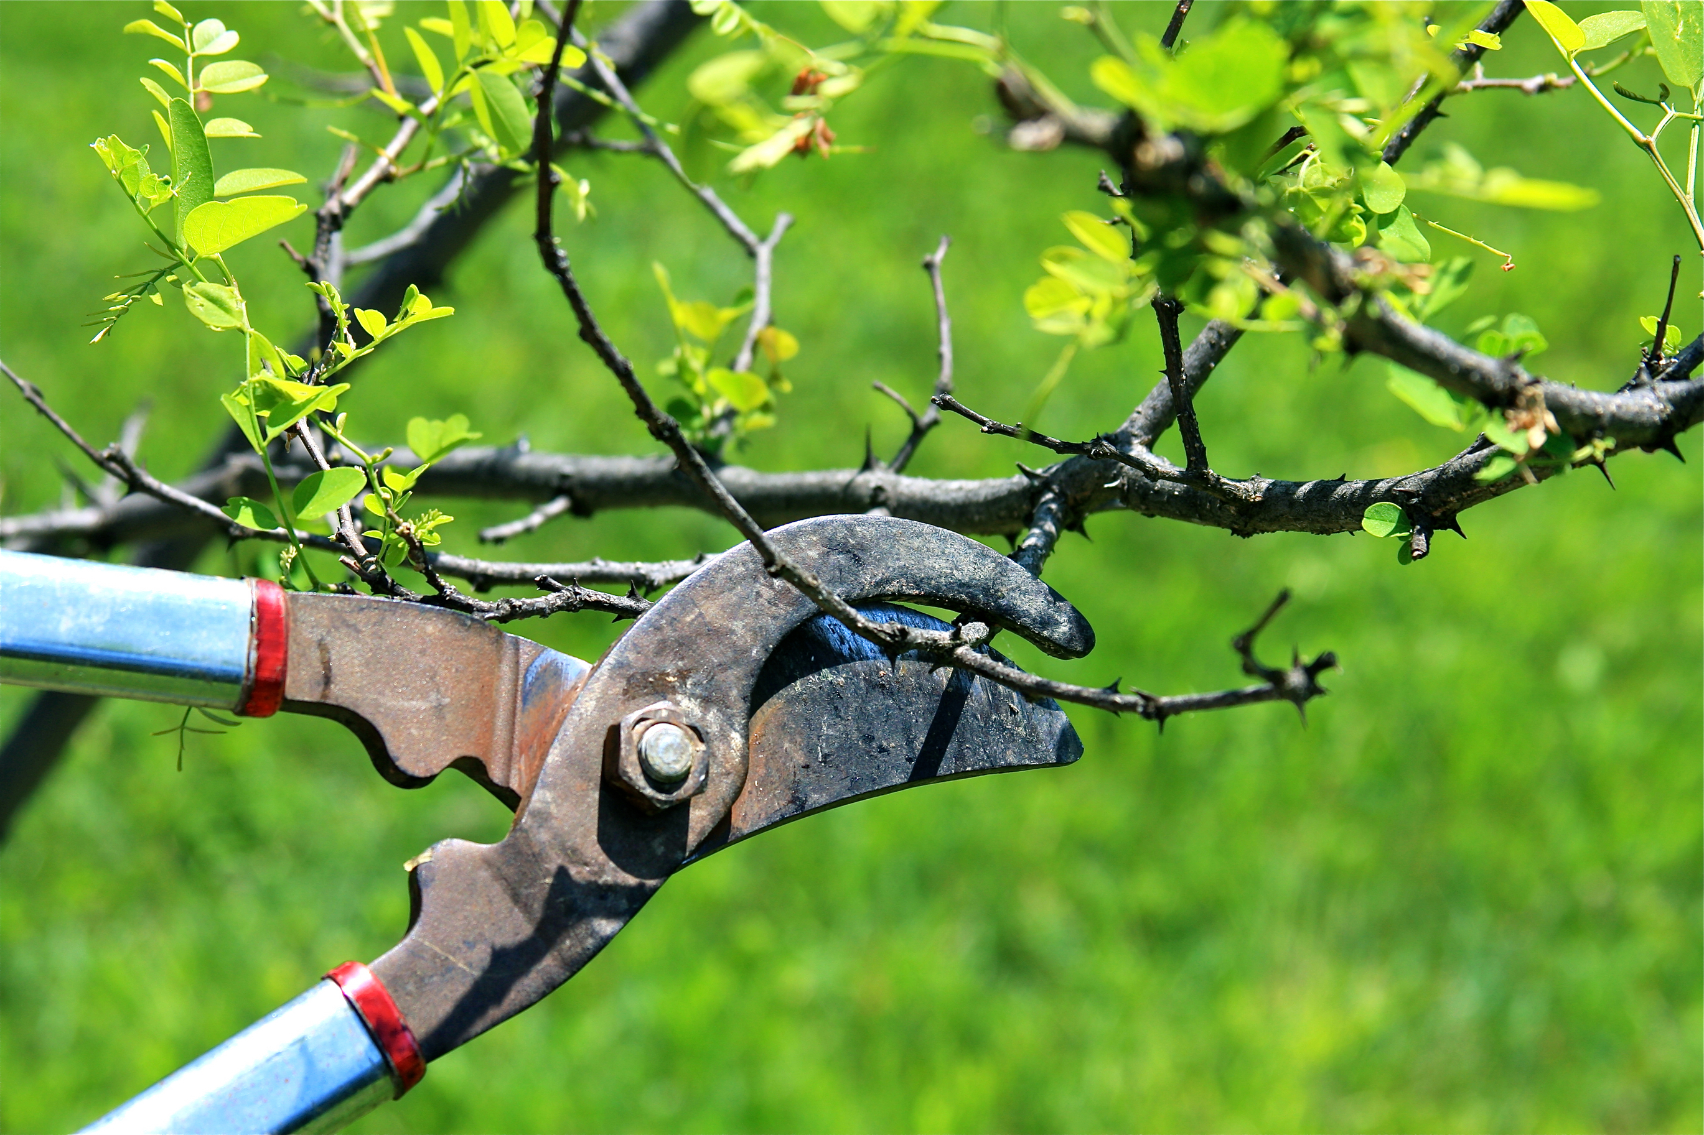
What Does Your Heart Reveal?
No fruit?
Little fruit?
Much fruit?
More fruit?
No connection
Needs pruning
Healthy
Growing
Notes:
If our fruit is the outward actions that results from the condition of our heart, what does our heart reveal?
Jesus said in John 15:2, 4, “Every branch in me that beareth not fruit he taketh away: and every branch that beareth fruit, he purgeth it, that it may bring forth more fruit.” “Abide in me and I in you. As the branch cannot bear fruit of itself, except it abide in the vine; no more can ye, except ye abide in me.”
NO FRUIT: If you are not producing fruit, then you are not connected to the vine. If you are not connected to the vine, then you are not connected to Jesus. If you are not producing Christian fruits, then you are taken away. Away from Jesus.
LITTLE FRUIT: If you are only producing a little fruit, then you need pruning.
Pruning includes deadwood removal, shaping (by controlling or directing growth), improving or maintaining health, reducing risk from falling branches, preparing for transplanting, and both harvesting and increasing the yield or quality of flowers and fruits.
Jesus said that we need to be purged or pruned. We need to remove the dead parts, we need to improve our spiritual health, we need to rid our selves of sin and obstacles that prohibit us from growing and producing fruits.
Romans 3:23 For all have sinned and come short of the glory of God.
Even though we produce much fruit, we can still prune ourselves from Satan’s temptations or unload some of the unnecessary tasks in our life that inhibits us from growing as Christians.
It’s been said that in a normal church 20% of the people do 80% of the work. If that’s true, if you take this mornings attendance and multiply it by 20%, you get…….. That means that ……do the other 20%. Is that OK with you? Is that OK with me? Is that OK with God?
Jesus said to purge- to prune---and when we do we will bear more fruit for Him….we will GROW.

Slide 6
Fruit of the Spirit
Galatians 5:22-23, 25
²² But the fruit of the Spirit is love, joy, peace, longsuffering, gentleness, goodness, faith,
²³ Meekness, temperance: against such there is no law.
²⁵ If we live in the Spirit, let us also walk in the Spirit.
Notes:
What kind of fruit do we want to bear? I would hope that all would say….Good fruit
Good fruit is that which is produced by the Holy Spirit. Galatians 5:22 gives us a starting place: the fruit of His Spirit is love, joy, peace, patience, kindness, goodness, faithfulness, gentleness, and self-control.
The more we allow the Holy Spirit free rein in our lives, the more this fruit is evident (Galatians 5:25). “If we live in the Spirit, let us also walk in the Spirit.” These fruits should be a part of our daily lives. They should abound!
Jesus told His followers, “I chose you and appointed you so that you might go and bear fruit—fruit that will last” (John 15:16). Righteous fruit has eternal benefit.

Slide 7
Signs of a Diseased Branch
Trunk Damage
Bare Branches
Damaged Roots
Dead branches can fall without warning and cause serious injury and property damage.
Diseased trees can spread to other trees.
Dead trees attract unwanted pests.
Notes:
Unrighteous fruit has eternal consequence.
Jesus told us clearly what we must do to bear good fruit, yet sometimes, we don’t.
Leah and I have a tree in the back yard. The bark is coming off. There’s a large section of the tree where the branches are bare. I know the tree is diseased and will need to be cut down soon.

Slide 8
Signs of a Diseased Christian
Trunk Damage
Bare Branches
Damaged Roots
Dead Christians can fall without warning; however, most are obvious.
Diseased Christians can spread to other Christians.
Dead Christians attract unwanted pests-Satan.
Notes:
A branch must stay firmly attached to the trunk to stay alive.
As disciples of Christ, we must stay firmly connected to Him to remain spiritually productive.
A branch draws strength, nourishment, protection, and energy from the vine. If it is broken off, it quickly dies and becomes unfruitful.
When we neglect our spiritual life, ignore the Word of God, skimp on prayer, and withhold areas of our lives from the scrutiny of the Holy Spirit, we are like a branch broken off the vine. Our lives become fruitless.
Romans 6:23 Wages of sin is death….
We need daily surrender, daily communication, and daily—sometimes hourly—repentance.
Staying intimately connected to the True Vine is the only way to “bear fruit in old age” (Psalm 92:14), to “run and not grow weary” (Isaiah 40:31), and to not “grow weary in well-doing” (Galatians 6:9).

Slide 9
God Gives the Increase
Reap what we sow. You will always harvest what you plant. Gal. 6:7
If we have starved our selves spiritually, it’s time to cut off the things that have prevented growth.
We were made to grow!
Paul planted. Apollos watered, but God gave the increase. 1 Cor. 3:6
Notes:
Galatians 6:7 Be not deceived; God is not mocked: for whatsoever a man soweth, that shall he also reap.

Slide 10
The Harvest Truly Is Great
Matthew 9:36 But when he saw the multitudes, he was moved with compassion on them, because they fainted, and were scattered abroad, as sheep having no shepherd.
Luke 10:2 Therefore said he unto them, The harvest truly is great, but the labourers are few: pray ye therefore the Lord of the harvest, that he would send forth labourers into his harvest.
Notes:
We have a chance to grow! So let’s go out and get busy serving the Lord and bearing fruit for Him!

