Slide 1
Come and See
John 2:43-46

Slide 2
John 1:43-46 “The day following Jesus would
go forth into Galilee, and findeth Philip, and
saith unto him, Follow me. Now Philip was of Bethsaida, the city of Andrew and Peter.
Philip findeth Nathanael, and saith unto him,
We have found him, of whom Moses
in the law, and the prophets, did write,
Jesus of Nazareth, the son of Joseph.
And Nathanael said unto him, Can there any good thing come out of Nazareth? Philip saith unto him, Come and see.”

Slide 3
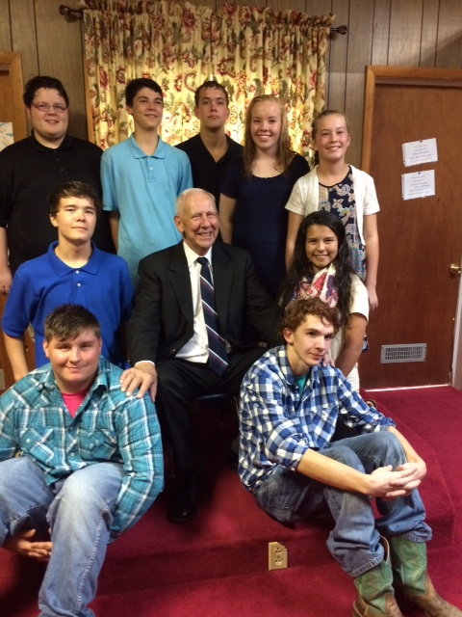
I have found the Messiah…

Slide 4
Nathanel said:
Can any good thing come out of Nazareth?

Slide 5
Come
and
See

Slide 6
Philip set a good example:
Come and See…

Slide 7
#1
Come and see the works of God
Psalm 66:5
Come and see the works of God: he is terrible in his doing toward the children of men.
NKJV Psalm 66:5 Come and see the works of God; He is awesome in His doing toward the sons of men.

Slide 8
Behold, what God hath done!!

Slide 9
Behold: Look
What God hath done for us

Slide 10
Given us opportunity to be in the church of Christ!
Acts 2:41 Added
Acts 2:47 Added
I Cor.12:13 Baptized into one body

Slide 11
Ephesians 2:14-17 “For he is our peace, who hath made both one, and hath broken down the middle wall of partition between us; Having abolished in his flesh the enmity, even the law of commandments contained in ordinances; for to make in himself of twain one new man, so making peace; And that he might reconcile both unto God in one body by the cross, having slain the enmity thereby: And came and preached peace to you which were afar off, and to them that were nigh.”

Slide 12
Romans 5:6-11 “For when we were yet without strength, in due time Christ died for the ungodly. For scarcely for a righteous man will one die: yet peradventure for a good man some would even dare to die. But God commendeth his love toward us, in that, while we were yet sinners, Christ died for us. Much more then, being now justified by his blood, we shall be saved from wrath through him. For if, when we were enemies, we were reconciled to God by the death of his Son, much more, being reconciled, we shall be saved by his life. And not only so, but we also joy in God through our Lord Jesus Christ, by whom we have now received the atonement.”

Slide 13
Come and See God’s glory in His Church!
Ephesians 3:20, 21 “Now unto him that is able to do exceeding abundantly above all that we ask or think, according to the power that worketh in us, Unto him be glory in the church by Christ Jesus throughout all ages, world without end. Amen.”

Slide 14
The Beauty of Both Jew and Gentile--united
Reconciliation of Jews and Gentiles.
Acts 10:34-35

Slide 15
The Same Church for which Jesus died
. Acts 20:28.
b. Ephesians 5:25 “Husbands, love your wives, even as Christ also loved the church, and gave himself for it;”
3) This is the church for which Jesus is the Savior. Ephesians 5:23 “For the husband is the head of the wife, even as Christ is the head of the church: and he is the saviour of the body.”

Slide 16
#2 Come and see the glory of God.
Isa. 66:18
¹⁸ For I know their works and their thoughts: it shall come, that I will gather all nations and tongues; and they shall come, and see my glory.

Slide 17
. We want men to see God’s glory in his word.
1) 2 Corinthians 4:6 “For God, who commanded the light to shine out of darkness, hath shined in our hearts, to give the light of the knowledge of the glory of God in the face of Jesus Christ.”
2) Colossians 1:27 “To whom God would make known what is the riches of the glory of this mystery among the Gentiles; which is Christ in you, the hope of glory:”

Slide 18
We want men to see the glory of God in the cross of the Master
Heb. 2:9-10
Heb. 12:1-2

Slide 19
We want people to see the glory of God
in how God changes people.

Slide 20
1. How God can change a sinner into a saint.
I Tim. 1:15 A Persecuter into a Persecuted!
Paul Gal. 1: 23 But they had
Heard only, that he which
Persecuted us in times past,
Now preacheth the faith which
Once he destroyed. “

Slide 21
2. How God can move a person from being a ‘lukewarm’ Christian To one that is all fired up for Jesus Christ. Rev.3:15-17; 2 Tim. 4:7,8
3. How God can touch our hearts and we want to be ‘more like Jesus”” I Pet.2:21
4. How God can heal our sick and return them to actively serving the Lord. Pray for the sick. Acts 2:42;

Slide 22
5. How God answers our prayers concerning those who Are not Christians.
Rom. 10:1-3
Pray earnestly for them.
6. What God will do if a nation turns to him.
Come and See.

Slide 23
2 Chron. 7:14-15
If my people, which are called
By my name, shall humble them-
Selves, and pray, and seek my face,
And turn their wicked ways; then
Will I hear from Heaven, and will
Forgive their sin, and will heal
Their land. V. 15 Now mine eyes
Shall be open, and mine ears attent
Unto the prayer that is made in this
Place.

Slide 24
# 3 Come and See Jesus
Heb.2:9-10
Heb.12:1-2
The Son of God
Matt. 17:1-5

Slide 25
What has God done for you?
What has God for me?
Make a list of all
Your blessings!!

Slide 26
Come and See
The Lord’s Plan to save us!
Hear…the gospel. Mark 16:15-16; Rom. 10:17
Believe that Jesus is the Son of God. John 8:24
Repent. Now. Change. Turn to the Saviour.
Acts 17:30-31
Confess His Sweet Name . Matt. 10:32,33

Slide 27
Be Baptized!
Acts 22:16
Acts 2:38
I Pet.3:21
Acts 8:36-38

Slide 28
Live FAITHFULLY..
Rev. 2:10
Rev. 14:13
I Cor.15:58

Slide 29
Erring Christians: Repent.
James 5:19-20
Confess you have been wrong. I John 1:8-10
I John 2:1-2
Pray. James 5:16

Slide 30
I have found the Messiah…

Slide 31
God’s unfolding of His plan of Salvation
God’s plan:
Hear, Believe, Repent, Confess and Be Baptized

Slide 32
Come and See the Glory of God
Isaiah 66:18 “For I know their works and their thoughts: it shall come, that I will gather all nations and tongues; and they shall come, and see my glory.”

Slide 33
They saw that He is the Son of God

Slide 34
Matthew 14:32-33 “And when they were come into the ship, the wind ceased. Then they that were in the ship came and worshiped him, saying, Of a truth thou art the Son of God.”

Slide 35
John 1:34, “And I saw, and bare record that this is the Son of God.”

