Slide 1
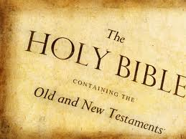
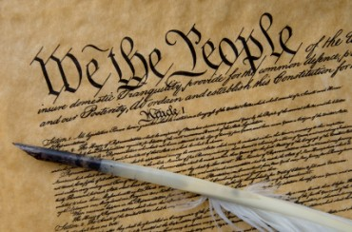
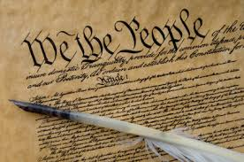
God vs. America The Bible vs. The Constitution

Slide 2
Religious Movements
Renaissance
Questioning Authority
Protestant Reformation
First protestant denominations
Colonization
Puritans and Pilgrims
Enlightenment
Separation of church and state
Great Awakening
Methodist
2nd Great Awakening
7th Day Adventist, Mormon, S. Baptist

Slide 3
What Did the Founding Fathers Believe?
Thomas Jefferson
God was not creator, but Providence
Wrote his own version of the NT
Distrusted Paul and miracles
George Washington
Most likely faithful
Religion and philosophy important
Why did founding fathers stress importance of freedom of religion?

Slide 4
The Constitution on Religion
1st Amendment
Congress shall make no law respecting an establishment of religion, or prohibiting the free exercise thereof; or abridging the freedom of speech, or of the press; or the right of the people peaceably to assemble, and to petition the government for a redress of grievances.

Slide 5
Landmark Supreme Court Cases
Engel v. Vitale (1962)
School prayer
Murray v. Curlett (1963)
School prayer and Bible reading
Wallace v. Jaffree (1985)
Moment of meditation or silent prayer
County of Allegheny v. ACLU (1989)
Nativity scene with message of God
Lee v. Weisman (1992)
Clergy led prayer at graduation
Chandler v. James (1997)
Alabama case student led prayer before event
Santa Fe Independent School District v. Doe (2000)
Student led prayer before games

Slide 6
The Bible vs. The Constitution
Can the Bible and the Constitution conflict with each other?
The extent of 1st Amendment
Separation of Church and State
Schools
Public policy
Political correctness
Mark 16:15
The Constitution does not protect all parts of religion

Slide 7
How Much Will American Culture Change in the next 100 years? 50 Years? 10 Years?

Slide 8
God’s Plan For Salvation
Hear
Acts 18:8
Believe
John 3:16; Mark 16:16; Acts 16:31
Confess
Matthew 10:32-33; Romans 10:9-10
Repent
Matthew 4:17; Acts 2:38; Luke 13:3; Acts 8:22
Be Baptized
Mark 16:14-20; John 3:3, 5-8; Romans 6:4; I Peter 3:21; Acts 2:38
Live a Faithful Life
Revelation 2:10

