Slide 1


Slide 2


Slide 3
Luke 1:39-45³⁹ And Mary arose in those days, and went into the hill country with haste, into a city of Juda;⁴⁰ And entered into the house of Zacharias, and saluted Elisabeth.⁴¹ And it came to pass, that, when Elisabeth heard the salutation of Mary, the babe leaped in her womb; and Elisabeth was filled with the Holy Ghost:⁴² And she spake out with a loud voice, and said, Blessed art thou among women, and blessed is the fruit of thy womb.⁴³ And whence is this to me, that the mother of my Lord should come to me?⁴⁴ For, lo, as soon as the voice of thy salutation sounded in mine ears, the babe leaped in my womb for joy.⁴⁵ And blessed is she that believed: for there shall be a performance of those things which were told her from the Lord.

Slide 4
Trust in God. Prov. 3:5-6
Heb. 13:5-6

Slide 5

To All Mothers
at O’Neal
2018

Slide 6
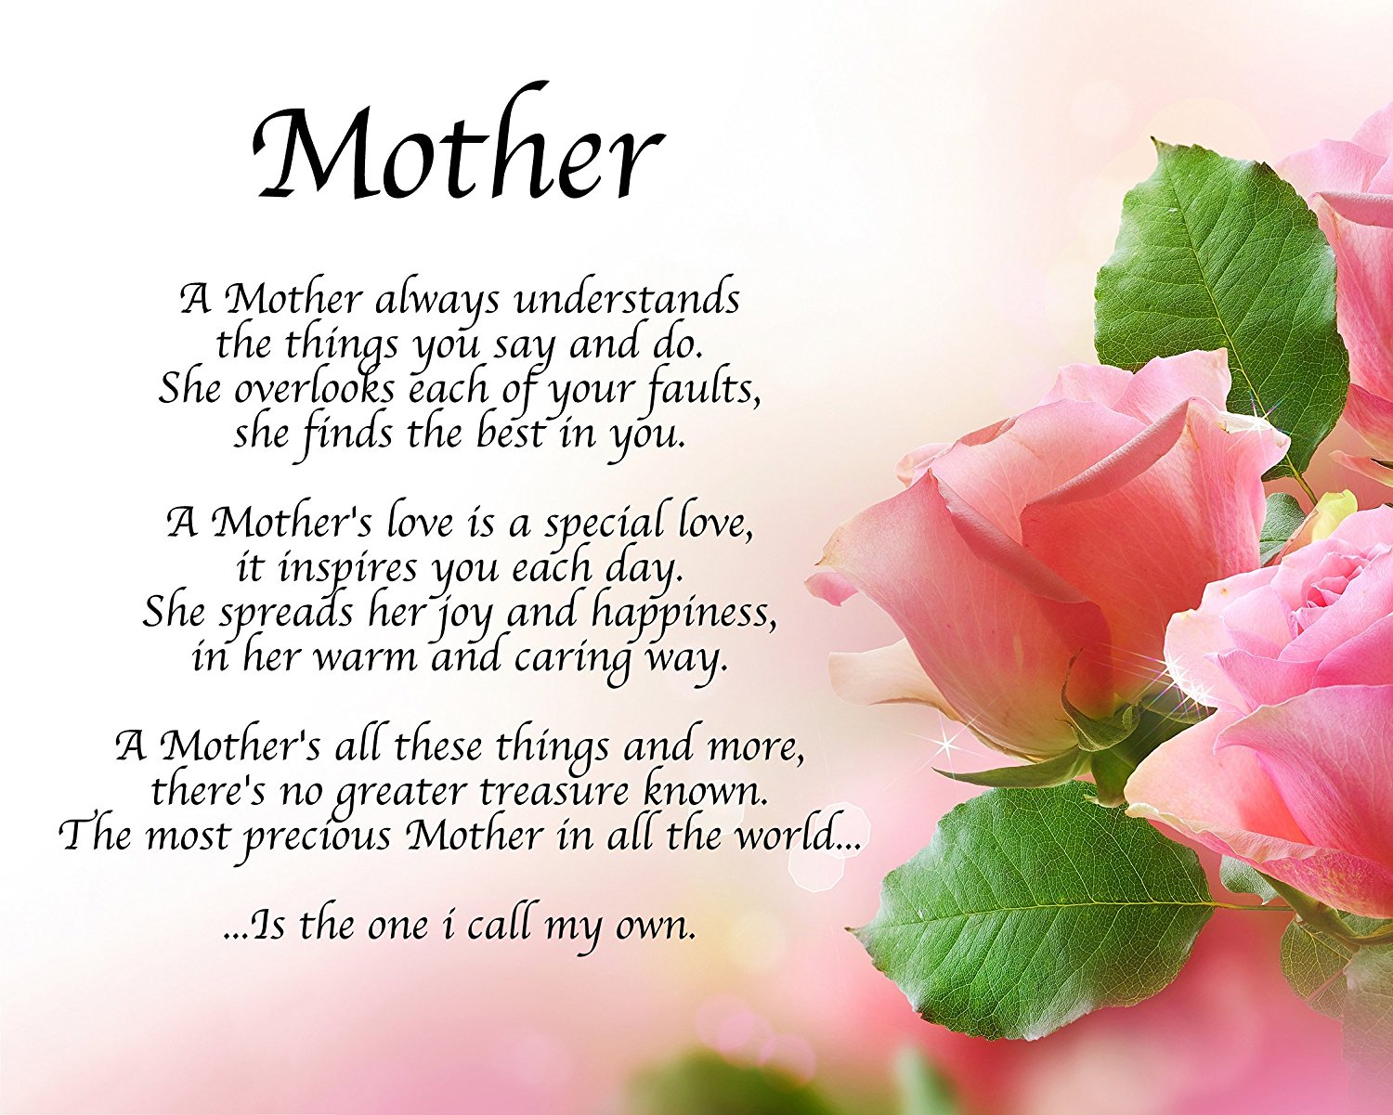

Slide 7
2 Tim. 1:1-5
1 Paul, an apostle of Jesus Christ by the will of God, according to the promise of life which is in Christ Jesus,
2 To Timothy, my dearly beloved son: Grace, mercy, and peace, from God the Father and Christ Jesus our Lord.
3 I thank God, whom I serve from my forefathers with pure conscience, that without ceasing I have remembrance of thee in my prayers night and day;
4 Greatly desiring to see thee, being mindful of thy tears, that I may be filled with joy;
5 When I call to remembrance the unfeigned faith that is in thee, which dwelt first in thy grandmother Lois, and thy mother Eunice; and I am persuaded that in thee also

Slide 8
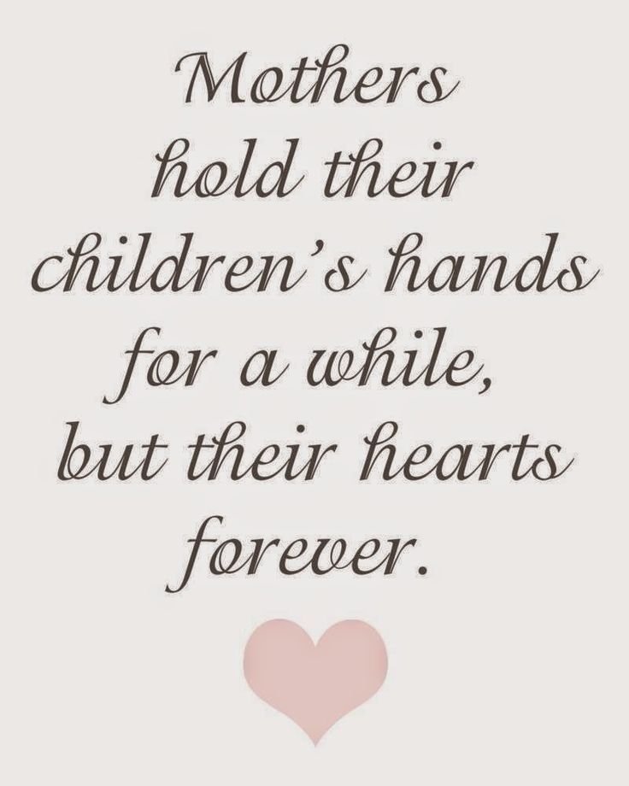

Slide 9
Psalms 127:3 - Lo, children [are] an heritage of the LORD: [and] the fruit of the womb [is his] reward.
Proverbs 22:6 - Train up a child in the way he should go: and when he is old, he will not depart from it.
Proverbs 6:20 - My son, keep thy father's commandment, and forsake not the law of thy mother:

Slide 10
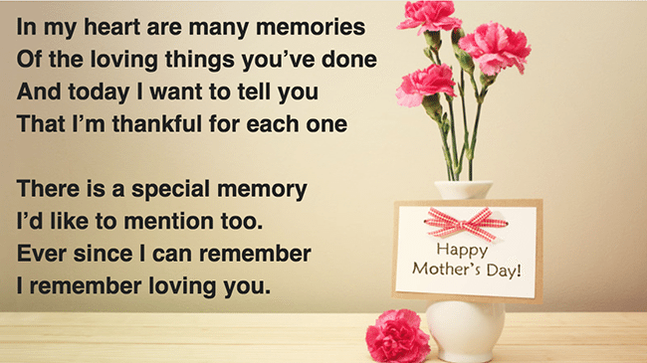

Slide 11
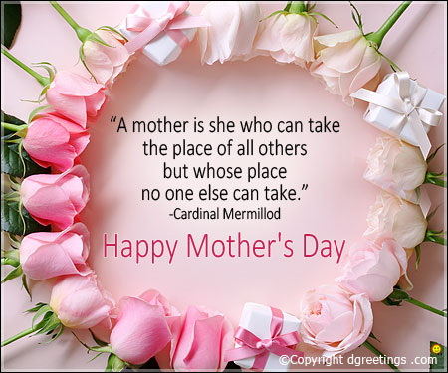

Slide 12
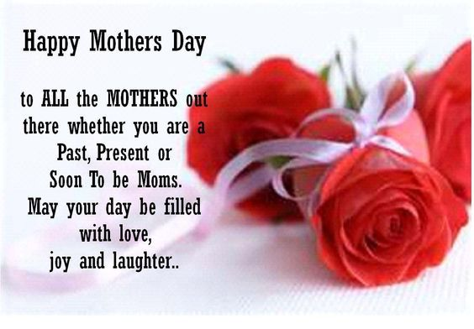

Slide 13
Ephesians 6:2 - Honour thy father and mother; (which is the first commandment with promise;
) Proverbs 23:22-25 - Hearken unto thy father that begat thee, and despise not thy mother when she is old
Exodus 20:12 - Honour thy father and thy mother: that thy days may be long upon the land which the LORD thy God giveth thee
Children must never forget this!

Slide 14
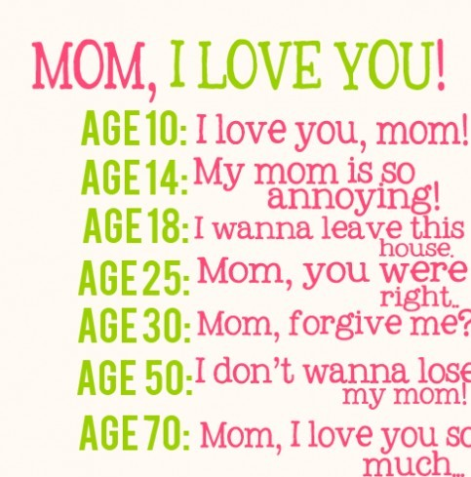

Slide 15


Slide 16
The bible stresses the vital role of women in the transmission of the faith. Not only is motherhood vital in the Old Testament, Paul calls out the mother of Timothy and his grandmother. He honors them for being the ones who gave Timothy a vision of what to believe.
“I am reminded of your sincere faith, a faith that dwelt first in your grandmother Lois and your mother Eunice and now, I am sure, dwells in you as well.”. (2 Tim 1:5)
If Paul called out moms and grandmothers for meritorious conduct, we should too!

Slide 17
There is a touching moment in Romans 16 Paul is sending his personal greeting to his friends in Rome. He says, effectively, “Say Hello to Rufus…and to his mother who was a mother to me.” (verse 13) Whoa! What did he just say?
As Paul sent greetings to Rufus, he mentions this about his mother: she was like a mother to the Great Apostle Paul.
. Whatever that meant for Paul, we should be thankful for her. And her care and love of Saul of Tarsus, the terrorist-turned-missionary, should inspire us all. Think about it. she was a mother to the most significant convert in the history of the church. Glory to God for her!

Slide 18
We know there are women who do not have children or who cannot have children. And there are many mothers who have lost children to early death or misfortune. But, we all have needed mothers in our own lives. And those moms, living or dead, good or bad, provided life for us…or to us.
We should at least give thanks for our mothers…all of our mothers

Slide 19
Let us never lose sight of time and opportunity.
Time to be with our beloved mothers
And opportunities to help them .

Slide 20
Take your Bible and turn to - Psalm 90
This psalm was penned by Moses, the man of God –
Deuteronomy 33:1
b. It is very much a psalm about time.
Notice the following words:
i. "generations" - Psalm 90:1
ii. "everlasting" - Psalm 90:2
iii. "years" - Psalm 90:4, 9-10
iv. "yesterday" - Psalm 90:4
v. "night" - Psalm 90:4
vi. "morning" - Psalm 90:5-6
vii. "evening - Psalm 90:6
viii. "days" - Psalm 90:9-10, 12, 14-15

Slide 21
Someone has suggested the following:
Special qualities most mothers have:
A mother is one who will nourish, love, and care for her children.
A mother is a night watchman as she keeps a ear out for her children’s cry at night, and she will immediately spring out of bed to comfort them.
A mother is a doctor and a nurse all rolled into one. No matter what kind of pain a child has, it is only a mother’s kiss that can make them feel better.

Slide 22
A mother is a time keeper as she keeps up with all the events in her children’s life, and she makes sure they make it to them on time.
A mother doubles as taxi driver or chauffer; whatever it takes to get her children where they need to go.
She is a chef, and she makes meals that are best for her children.
A mother is a councilor and works with her children’s emotions during difficult times.
A mother is a referee when it comes to disputes between her children.

Slide 23
A mother is a great comforter when her child wakes up from a bad dream or bad weather.
A mother is great encourager who gives her children what they need to succeed.
Even though a mother is overworked and underpaid, she doesn't complain.
She would work her fingers to the bone for her children.
She is willing to come to their rescue, no matter what the cause.

Slide 25
What ‘gift’ can a child give to his/her mother
That is worth everything to her?
The giving of themselves to serve God. Matt. 6:33
What gift can a mother give to a child that is
Worth everything to him/her?
A mother that is a Christian, faithful to God.Matt. 5:16

Slide 26
The Gospel is for all.
It is God’s power to save! Rom.1:16
Hear it. Rom. 10:17
Believe it. Mark 16:15-16
Repent. Acts 17:30-31
Confess Christ. Matt. 10:32-33
Be baptized I Pet.3 :21
Be faithful. Rev. 2:10; I Cor.1 5:58

