Slide 1
The conversion of paul
An Example We Should Follow

Slide 2
Paul’s background
Stoning of Stephen
  Acts 7:58
  Acts 8:1 Now Saul was consenting to his death. At that time a great persecution arose against the church which was at Jerusalem; and they were all scattered throughout the regions of Judea and Samaria, except the apostles.
  Acts 8:3 - As for Saul, he made havoc of the church, entering every house, and dragging off men and women, committing them to prison
Saul led the persecution against the church

Slide 3
Saul is converted
Acts 9
  1-19 - conversion of Saul
  20-22 – Saul preaches the word
  23-30 – Saul is persecuted
Acts 13: 4-12 – Paul confronts Bar-Jesus
Acts 14: 19-20 – Paul stoned, left for dead
Paul went from persecuting the church to being one of its leaders and was persecuted himself

Slide 4
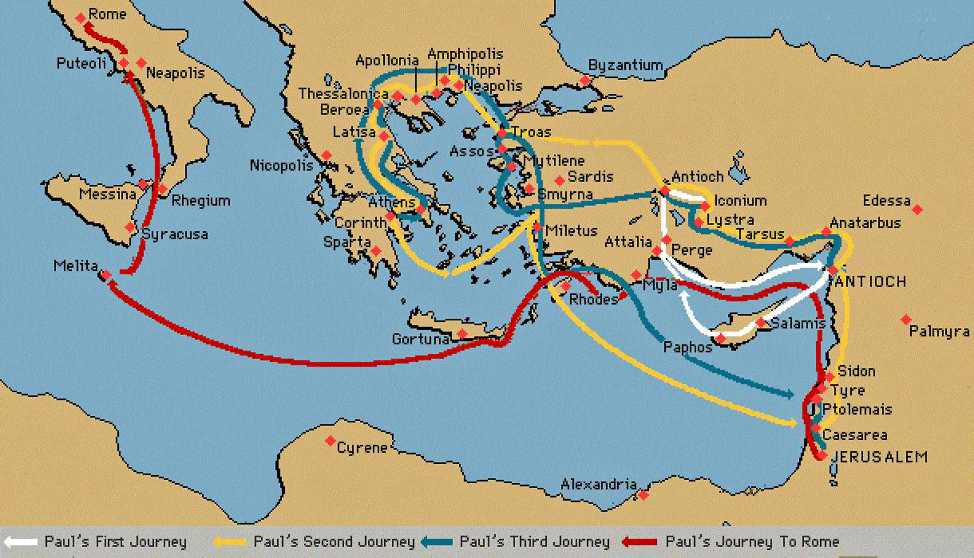
Paul’s resume
Paul made 4 journeys over a period of 16 years that stretched from modern day Israel, Turkey, Greece, and Italy

Slide 5
Paul’s resume
Paul is also known for writing 14 books of the New Testament:
  Romans
  I and II Corinthians
  Galatians
  Ephesians
  Philippians
  Colossians
  I and II Thessalonians
  I and II Timothy
  Titus
  Philemon
  Hebrews (it is believed that Paul wrote this book, even though there is no early manuscript to support it)

Slide 6
Hear
Matthew 7:24-27
  24. “…whoever hears these sayings of Mine, and does them, I will liken him to a wise man who built his house on the rock:”
  26. “…everyone who hears these sayings of Mine, and does not do them, will be like a foolish man who built his house on the sand:”
Romans 10:17
Paul heard the words of Jesus on the road to Demascus

Slide 7
Believe
Mark 16:16
  “He who believes and is baptized will be saved; but he who does not believe will be condemned.”
John 3:16
  “For God so loved the world that He gave His only begotten Son, that whoever believes in Him should not perish, but have everlasting life.”
Acts 16:31
Hebrews 11:6
John 12:47
Paul did not question Jesus on the road to Demascus…he believed the very words that Jesus said

Slide 8
Repent
Luke 13:3
  “…unless you repent you will all likewise perish.”
Acts 2:38
  “Then Peter said to them, ‘Repent, and let every one of you be baptized in the name of Jesus Christ for the remission of sins: and you shall receive the gift of the Holy Spirit.”
Matthew 4:17
Acts 8:22
Even though Paul persecuted Christians, he repented of his sins and turned to God

Slide 9
Confess
Matthew 10:32-33
  32. “Therefore whoever confesses Me before men, I will also confess before My Father who is in heaven. 33. “But whoever denies Me before men, him I will also deny before My Father who is in heaven.”
Romans 10:9-10
  9. “that if you confess with your mouth the Lord Jesus and believe in your heart that God has raised Him from the dead, you will be saved.
  10. For with the heart one believes unto righteousness, and with the mouth confession is made unto salvation.”
Acts 8:36-37
With his teachings to others, Paul confessed Jesus before other men

Slide 10
Be baptized
Mark 16:14-20
  16. “He who believes and is baptized will be saved; but he who does not believe will be condemned.”
John 3:3, 5-8
  5. “Jesus answered, ‘Most assuredly, I say to you, unless one is born of water and the Spirit, he cannot enter the kingdom of God.”
Acts 2:38
Romans 6:4
I Peter 3:21
Paul arose and was baptized by Ananias (Acts 9:17-18)

Slide 11
Preach the gospel
Mark 16:15
  Jesus told the Apostles to “Go into all the world and preach the gospel to every creature.”
Paul preached the gospel to every creature that he encountered, as we saw in his four journeys
There are also numerous examples in the New Testament of Jesus, His disciples, and the apostles preaching the gospel

Slide 12
Live a faithful life
Revelation 2:10
  “Do not fear any of those things which you are about to suffer. Indeed, the devil is about to throw some of you into prison, that you may be tested, and you will have tribulation ten days. Be faithful until death, and I will give you the crown of life.”
After being converted, Paul remained faithful for the rest of his life

Slide 13
God’s plan of salvation
Hear
  Matthew 7:24-27; Romans 10:17
Believe
  John 3:16; Mark 16:16; Acts 16:31
Repent
  Matthew 4:17; Acts 2:38; Luke 13:3; Acts 8:32
Confess
  Matthew 10:32-33; Romans 10:9-10; Acts 8:36-37
Be Baptized
  Mark 16:16; John 3:3, 5-8; Romans 6:4; I Peter 3:21; Acts 2:38
Live a Faithful Life
  Revelation 2:10

